Slide 1
Cybersecurity: Best Practices in Office Buildings

Slide 2
Cybersecurity: Best Practices in Office Buildings
Chris Peckham Ollivier Corporation Director of Operations chrispeckham@olliviercorp.com | Fred Gordy Director of Cyber Security & Managing Consultant Intelligent Buildings, LLC fred.gordy@intelligentbuildings.com
Wednesday, October 28, 3:00 PM – 3:30 PM PT

Slide 3
Learning Objectives
The participant will understand the importance of cybersecurity and how it can impact a business.
The participant will be reminded of good cyber hygiene practices and what can be done to improve their current environment.
The participant will have a better understanding of building control systems, how these systems may be exposed, and what can be done to reduce the cybersecurity risk to them.

Slide 4
Introduction
Background
It’s the simple things
Operator/Management Exposure
Cyber Hygiene
Current Threats to Building Control Systems (BCS)
What is the “Norm”
Easy, Low Cost Wins
Wrap-up
Discussion / Q&A

Slide 5
Background
Cybersecurity is the state or process of protecting and recovering computer systems, networks, devices, and programs from any type of cyber attack. Cyber attacks are an increasingly sophisticated and evolving danger to sensitive data, as attackers employ new methods powered by social engineering and artificial intelligence to circumvent traditional security controls.
https://www.upguard.com/blog/cybersecurity-important
Lack of focus on cybersecurity can damage a business: economic costs, reputational costs, regulatory costs

Slide 6
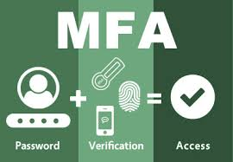
It’s the simple things
Phishing
Poor grammar
Logo use
Request from manager
Wire transfer requests
Protect mobile device
Lock codes
Review apps- Look at where data is going
Ability to remote wipe
Accounts
MFA
Don’t mix personal and business email
Social Media information

Slide 7
Operator/Management Exposure
Keep software updated
Password management
Network access (Who, VPN, wireless routers, open ports, etc.)
Unsecured network usage (free? WiFi)
Data security threats – data breaches, phishing, etc.
Who can access your systems?
Vet your vendors – assessment process

Slide 8
More in Depth Cyber Hygiene
A Baseline Set of Practices Cybersecurity hygiene - managing the most common and pervasive cybersecurity risks
Identify and prioritize key organizational services, products and their supporting assets.
Identify, prioritize, and respond to risks to the organization’s key services and products.
Establish an incident response plan.
Conduct cybersecurity education and awareness activities.
Establish network security and monitoring.
Control access based on least privilege and maintain the user access accounts.
Manage technology changes and use standardized secure configurations.
Implement controls to protect and recover data.
Prevent and monitor malware exposures.
Manage cyber risks associated with suppliers and external dependencies.
Perform cyber threat and vulnerability monitoring and remediation.
https://resources.sei.cmu.edu/asset_files/Presentation/2017_017_001_508771.pdf
CIS, NIST, CMU SEI

Slide 9
Real World Example - External
Parking Printer Emptied Building
Multiple Floors Affected
Multi-tenant commercial real estate
Occupants Evacuated
2 high value target tenants
Hours Lost Productivity
Vendor Responsible
Wireless
Printer
Printed
Message

Slide 10
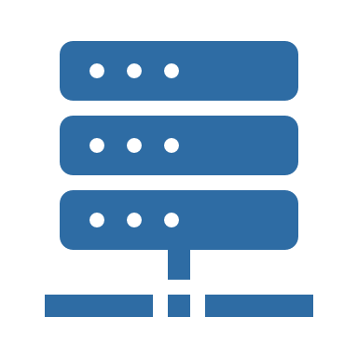
Real World Example - External
Ransomware & Attack
Long Recovery
50
Floors
Commercial real estate
1200 +
Occupants Affected
30% of tenants unable to work
92
1,040 + man hours to recover
Days to Recover
Public IP

Slide 11
Real World Example - Internal
Fired Employee Credential Removed
Over 100 Buildings Offline
SUPERVISORY
CONTROLLER
Application
SUPERVISORY
CONTROLLER
Building 1
APPLICATION
HOST
Application
Building 50
100 +
Buildings Affected
Lost connectivity to hospitals, medical office buildings, and admin buildings
2
Outside Sources
Contractor
6
Weeks
Building connectivity restored
Manufacturer
Additional weeks needed to get all issues cleared
SUPERVISORY
CONTROLLER
Application
Application
HQ
Building 100
SUPERVISORY
CONTROLLER
SUPERVISORY
CONTROLLER
Application
Application
Building 300 +
Building 150

Slide 12
Real World Example - Internal
Vulnerability Scan on Newly Commissioned Building
101
Floors
Multi-tenant media & entertain real estate
10K +
Commission devices
10 system types
60% +
Device offline
Majority require manual restart
IT Vulnerability
Scan

Slide 13
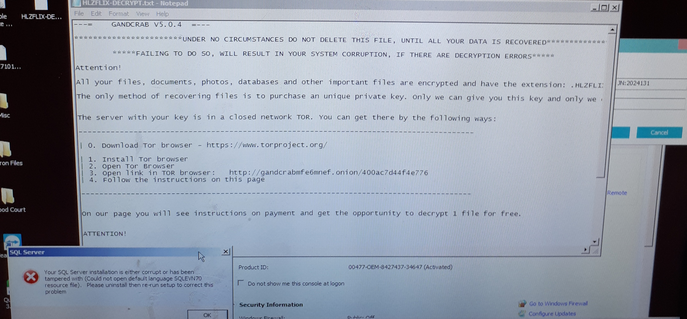
Ransomware #1 Threat

Slide 14
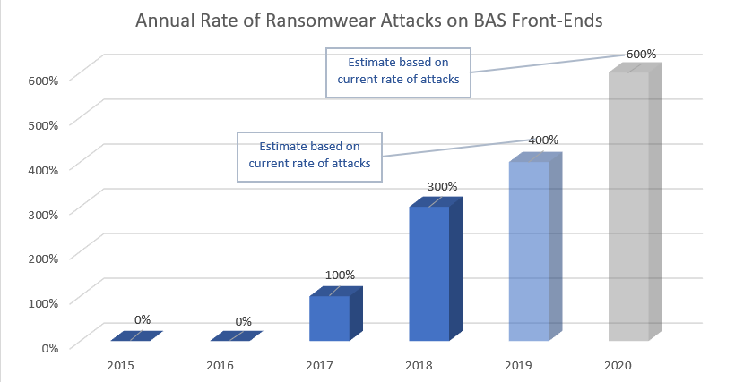
Attacks Are Increasing

Slide 15
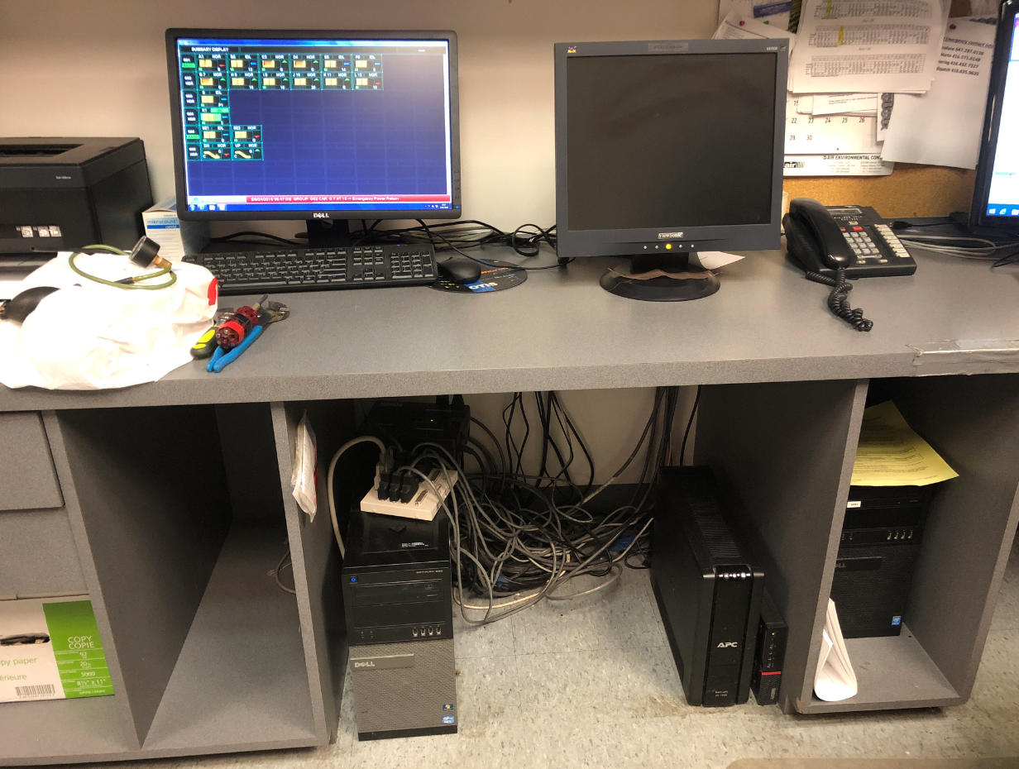
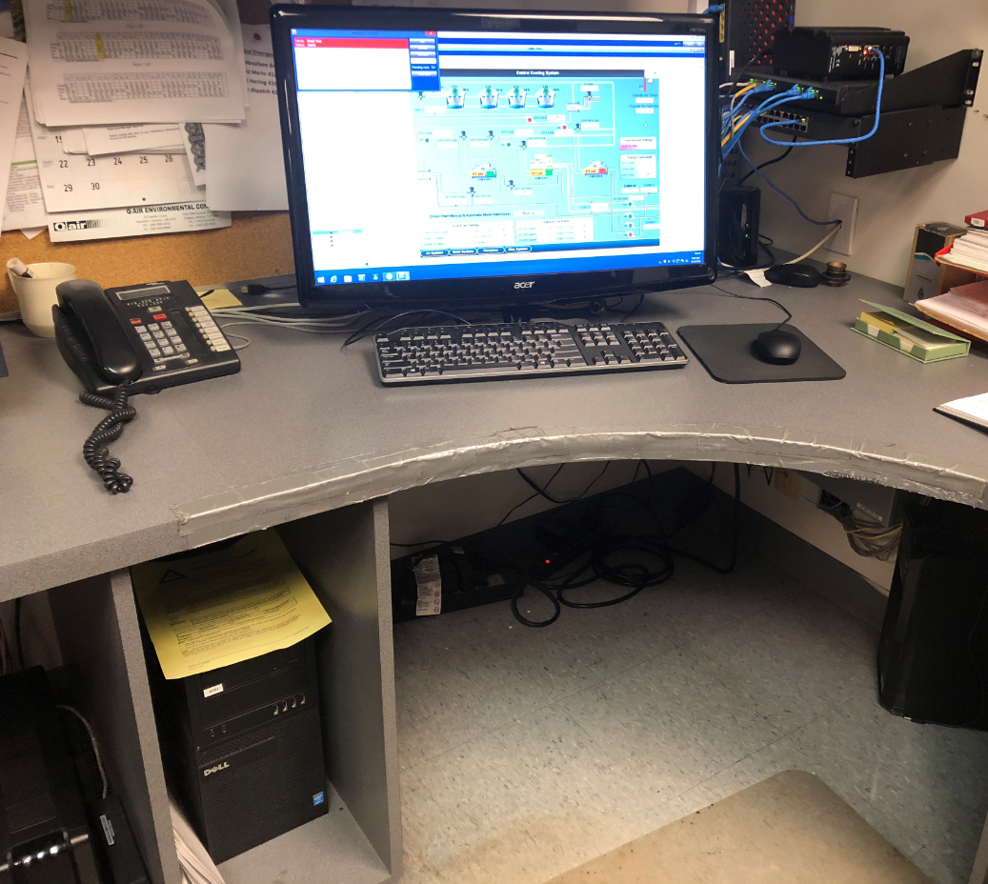
Typical Findings - Insecure
Engineers Office
Logged in and unrestricted use by anyone. Shared user account and activity not monitored.

Slide 16
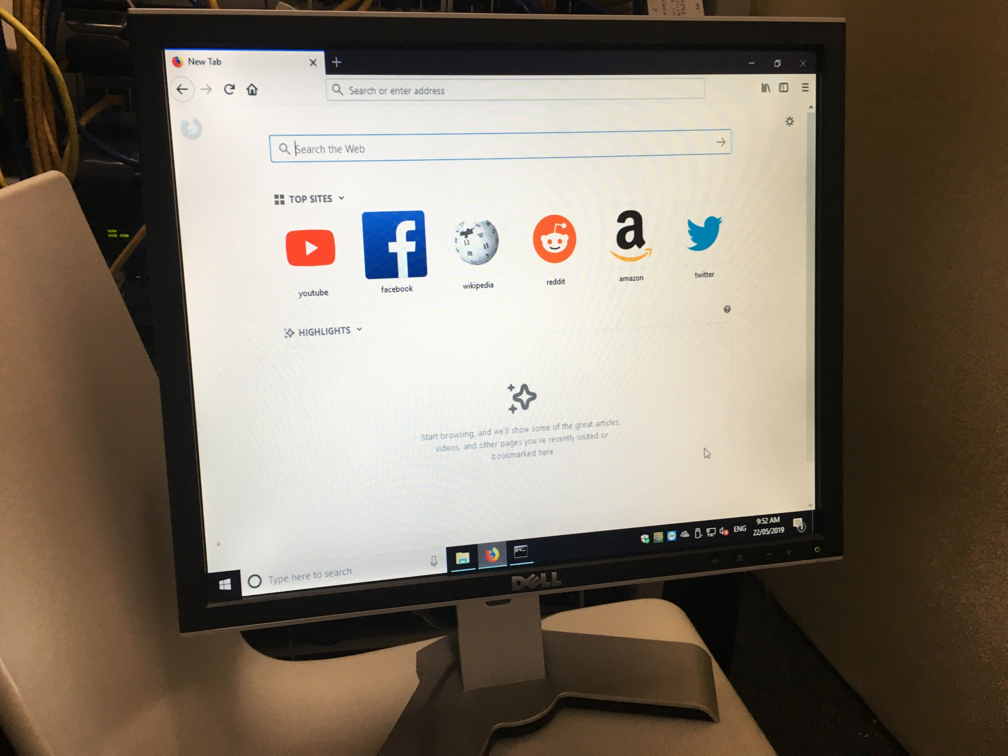
Typical Findings – Personal Use
Located in a “Secure” Rack

Slide 17
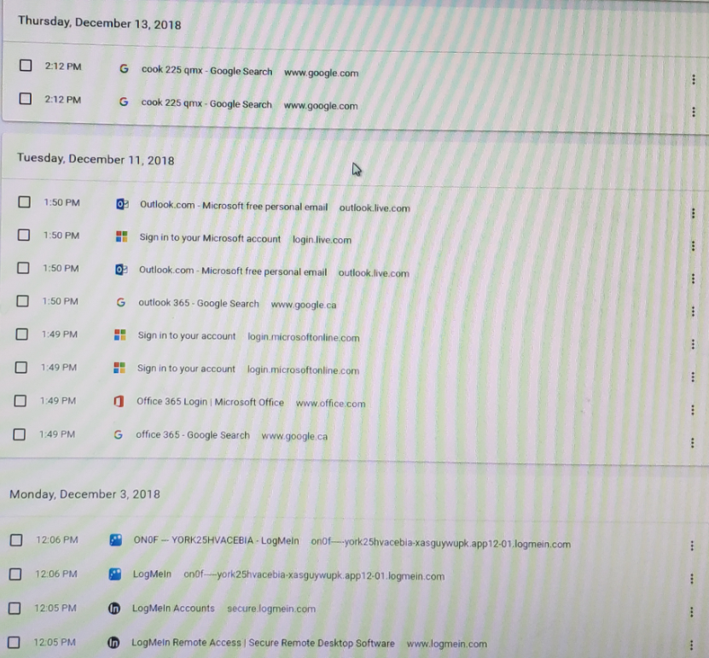
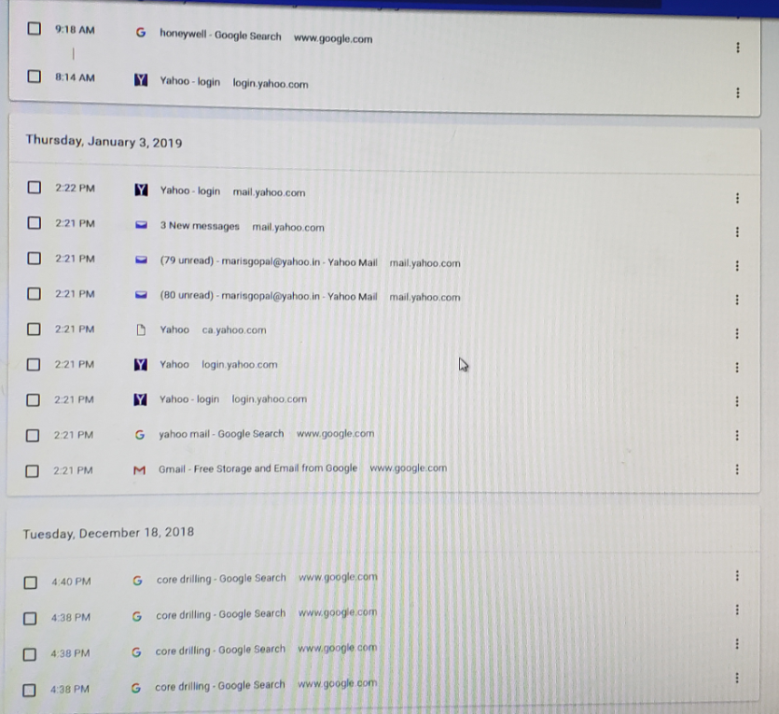
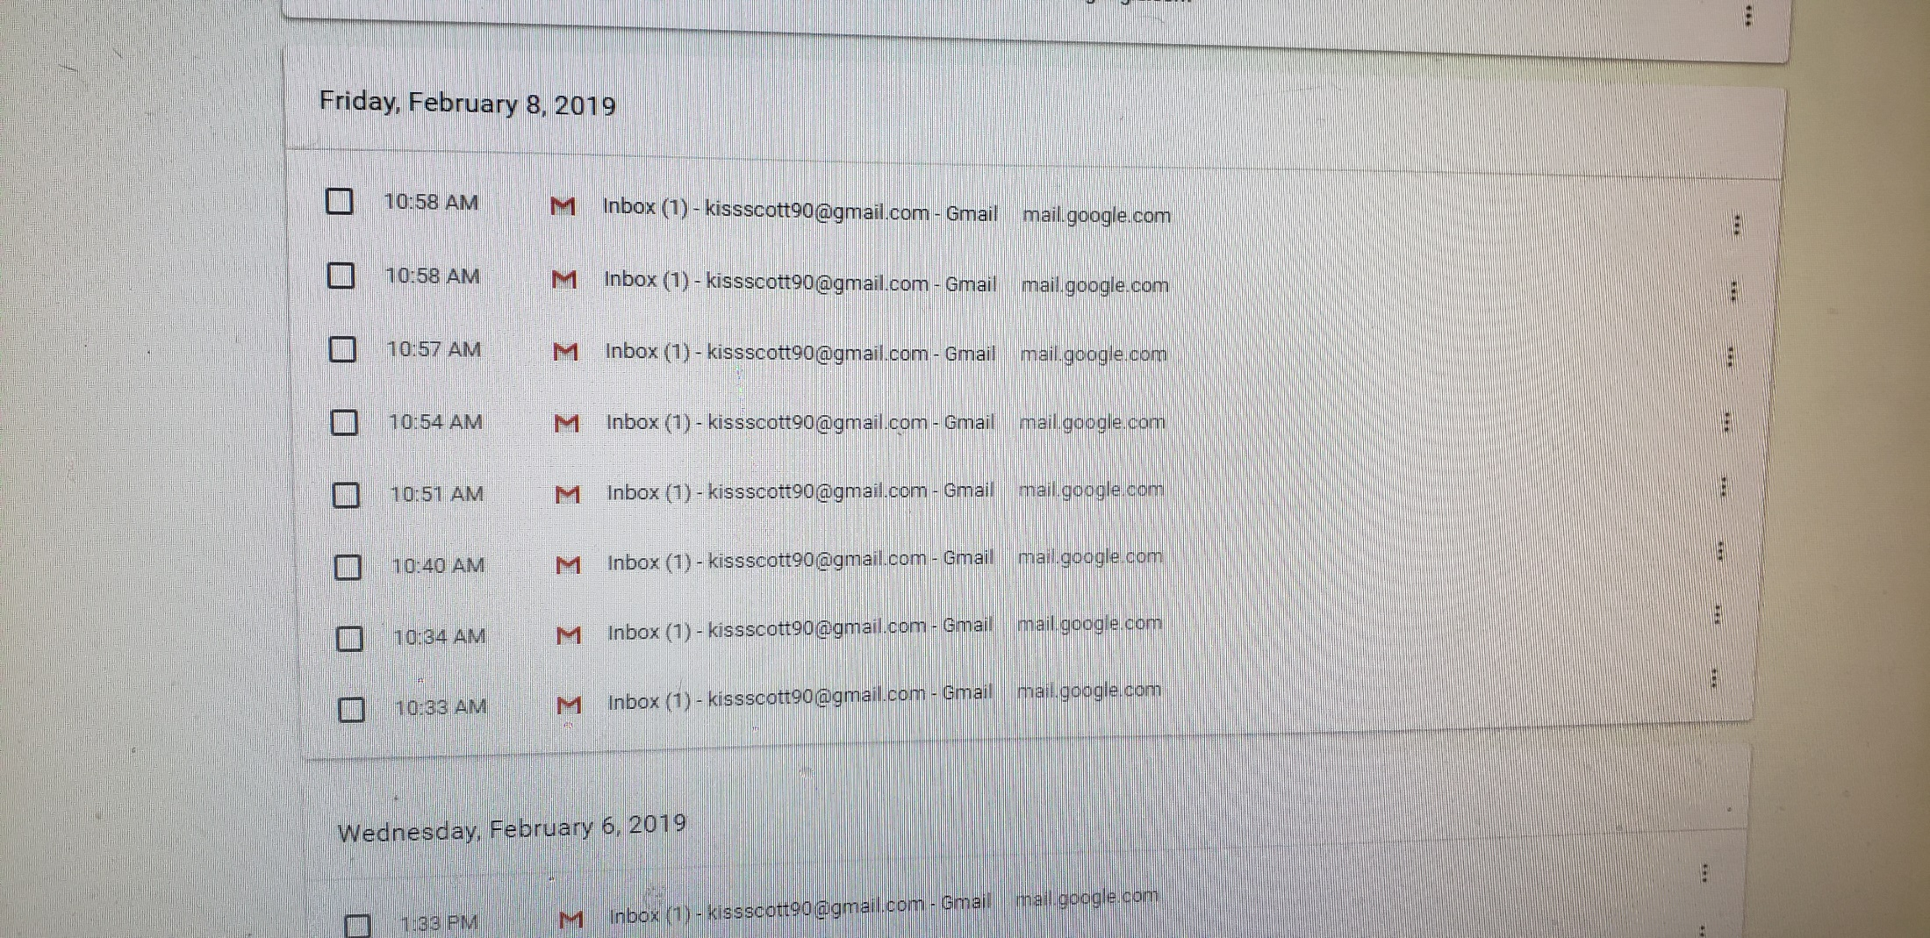
Typical Findings – Personal Use

Slide 18
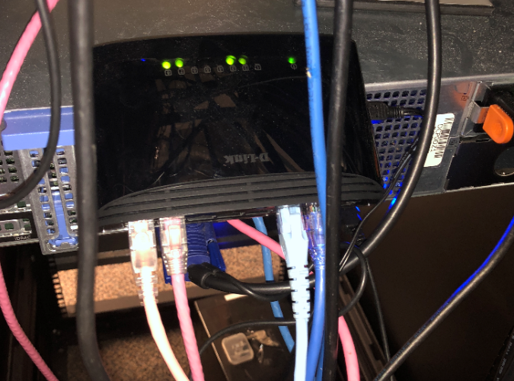
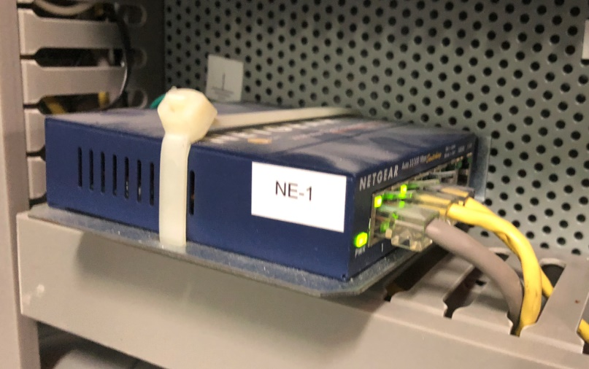
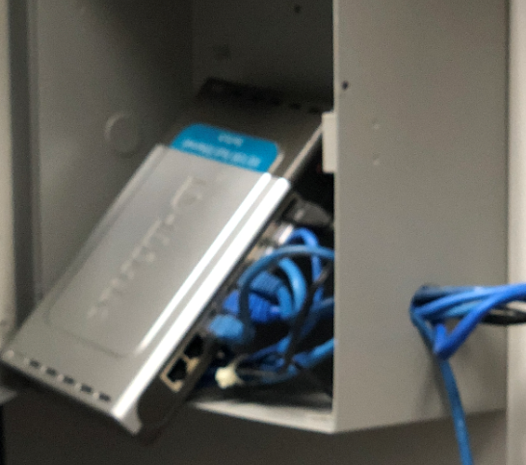
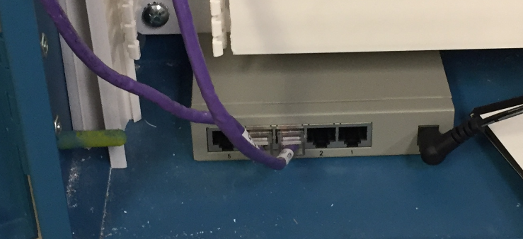
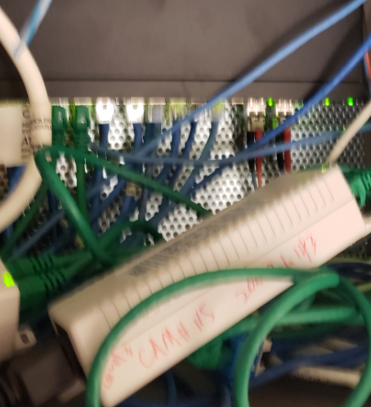
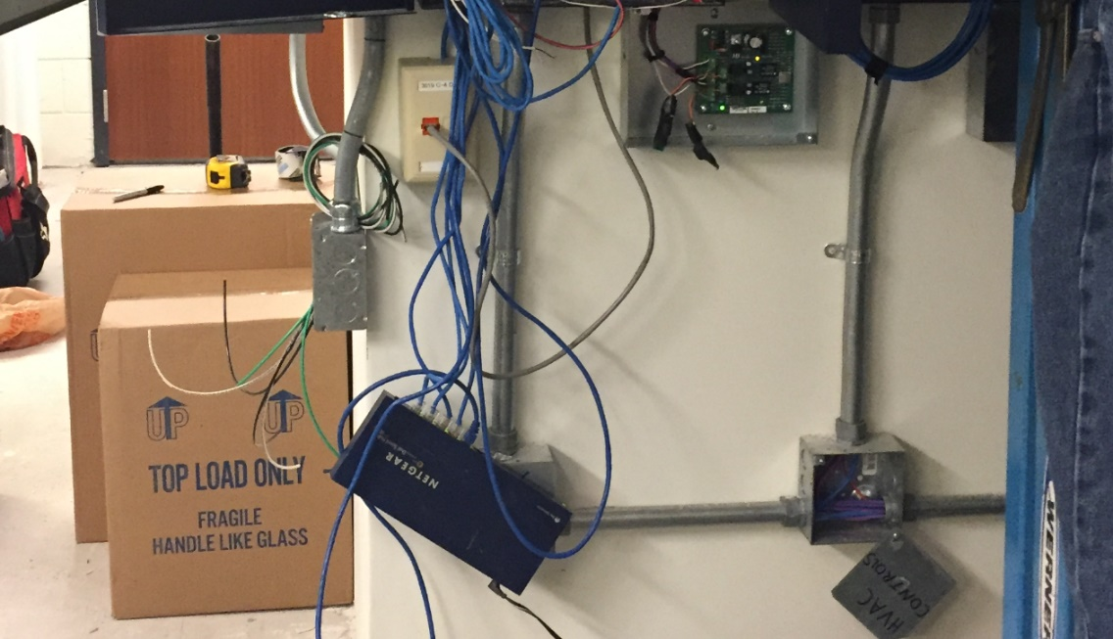
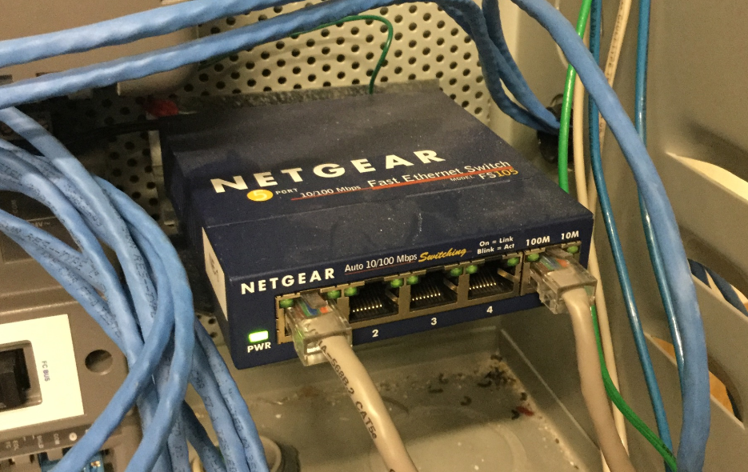
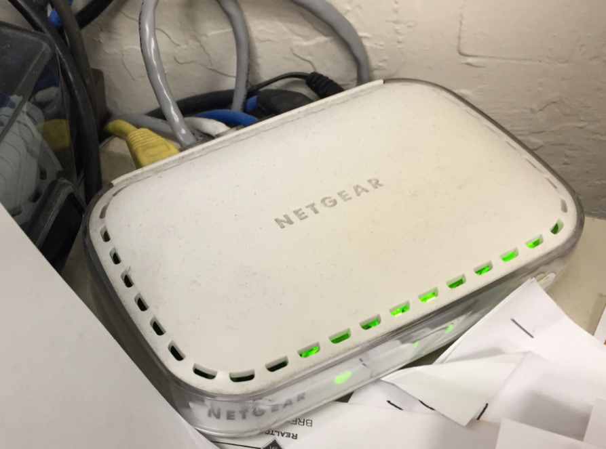
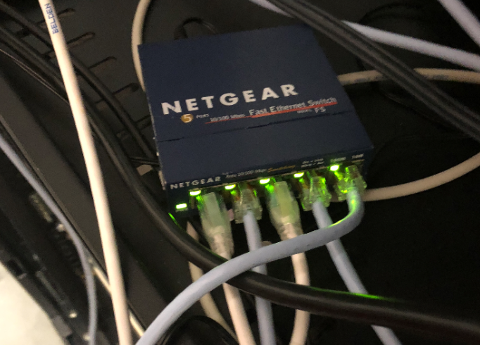
Typical Findings – No Control
Unknown, Unmanaged Switches
Hospital
Financial Group
Bank
Military Base
Bank
Military Base
Hospital
Commercial Realty
Financial Group

Slide 19
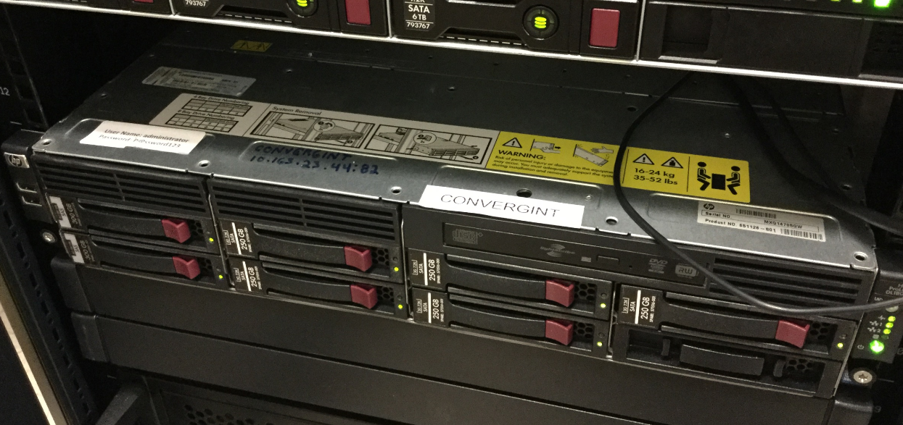
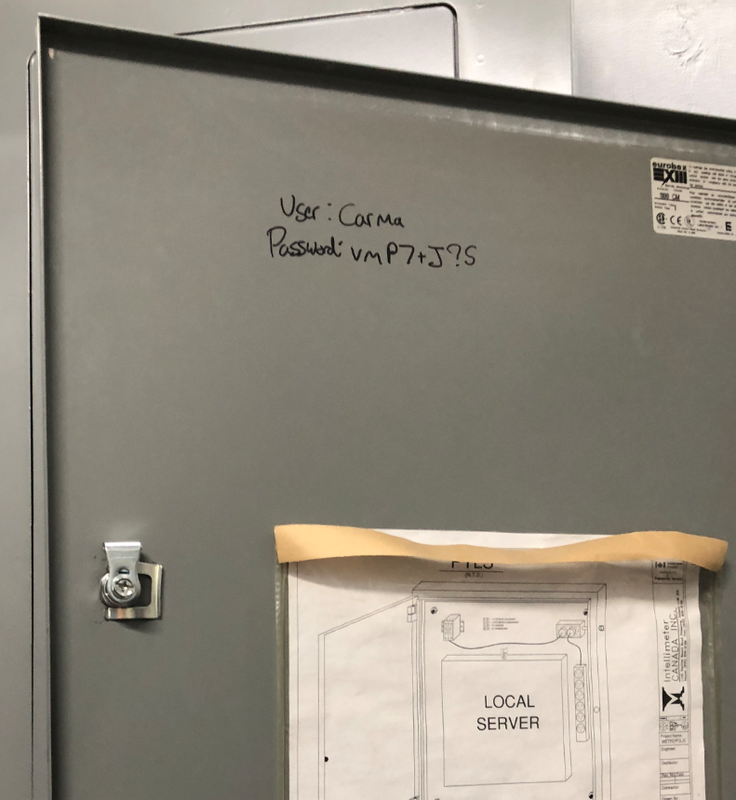
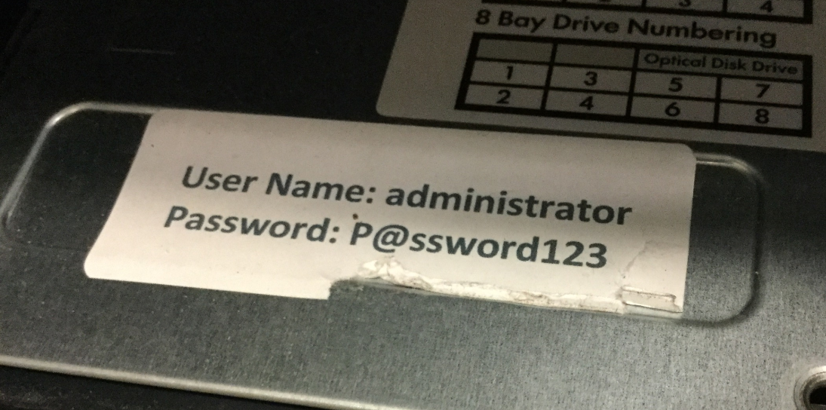
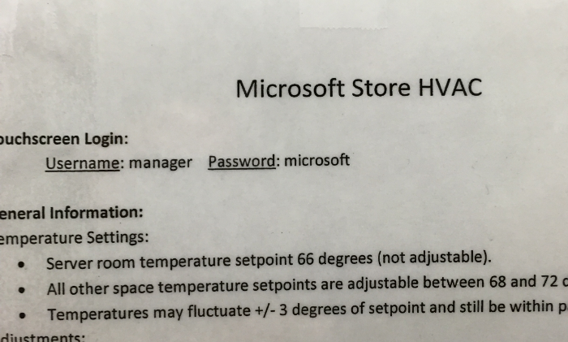
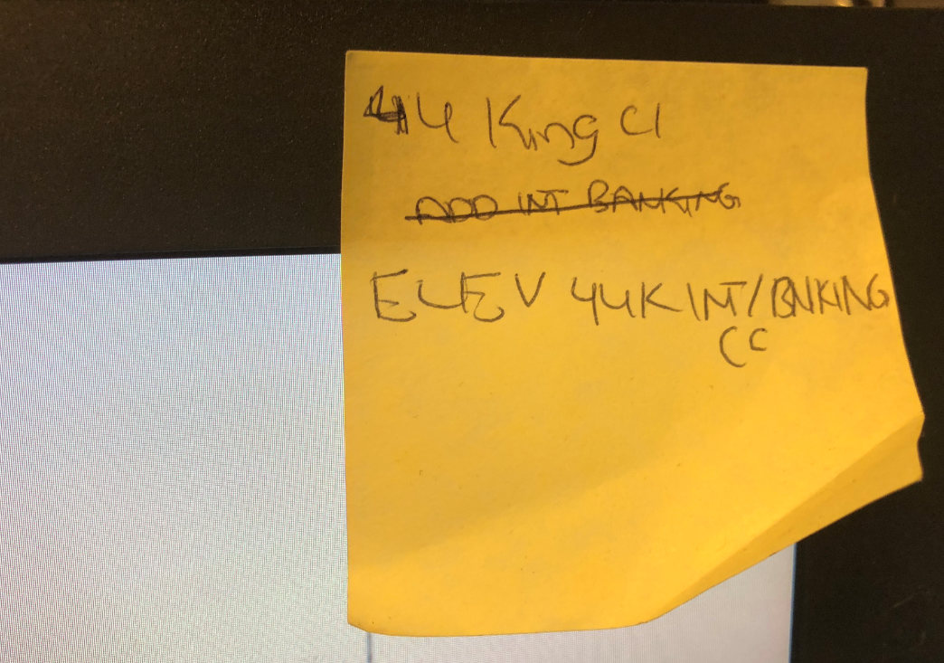
Typical Findings – Misuse

Slide 20
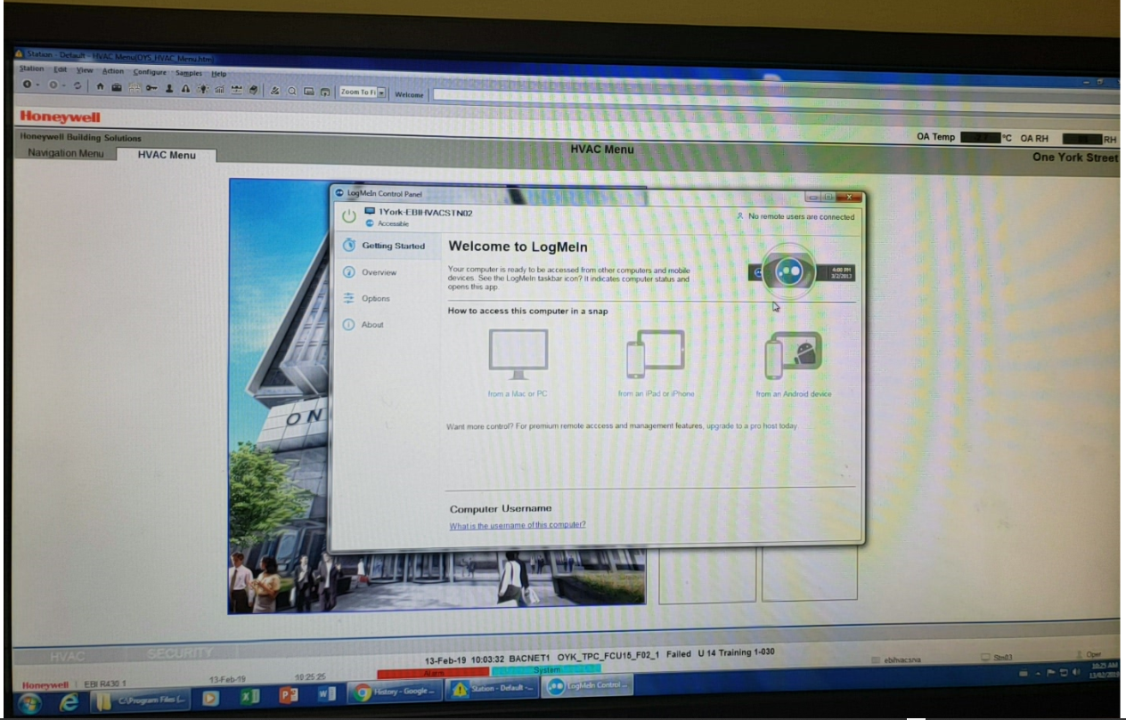
Typical Findings – Vendor Access

Slide 21
Easy, Low Cost Wins
Basic best practices that can strengthen your BCS posture
Know What You Don’t Know – Identify Your Assets
Know What You Don’t Know – What Is Your Exposure
Vendor Management & Compliance – Do You Control Them or Do They Control You
Assess Configurations – Users, Default Settings, Vendor Defaults
Basic Disaster Recovery – Backup and Backup Right
Basic Best Practices – Train Your People and Your Vendors

Slide 22
Wrap-Up
Background
It’s the simple things
Operator/Management Exposure
Cyber Hygiene
Current Threats to Building Control Systems (BCS)
What is the “Norm”
Easy, Low Cost Wins
Wrap-up
Discussion / Q&A

Slide 23
Discussion / Q & A
https://cdn.imgbin.com/25/11/23/imgbin-discussion-group-internet-forum-focus-group-AJZZU8fYpRnmaQqvGQgYMDVe6.jpg

