Slide 2
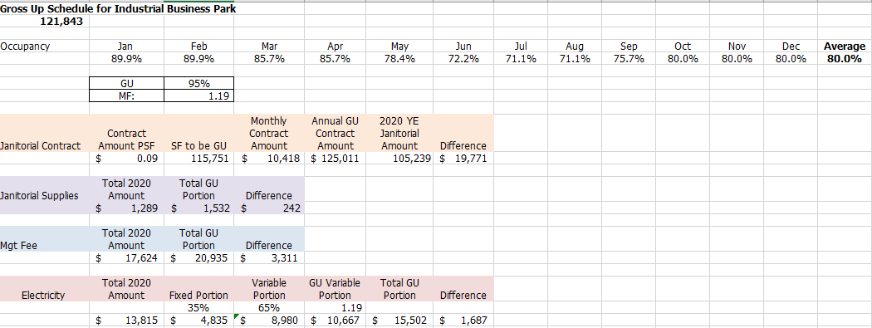
THE EXTRAS!
Gross Ups
What is being grossed up?
What fluctuates with occupancy?
What is it being grossed up to?
Check the lease – even NNN!
What was the occupancy %?
Multiplication factor = GU% divided by occupancy (.95/.80)
Multiply variable expense by multiplication factor
Angela Gomez-jones, RPA®
Director of property Management,
Link logistics real estate
agomezjones@linklogistics.com

Slide 3
Capital Expenditures
If the building value is increased by the expenditure, it is a capital expense rather than an operating expense
Capital Expenses typically can be included as an operating expense, if it is considered a “cost saving improvement” or the lease allows for the recovery of the expense.
Cost Saving Capital Improvements can be considered a recoverable operating expense and handled in one of the following ways:
Expense in one year
Expense over the useful life or payback period without a percentage applied as amortization
Expense over the useful life or payback period with a percentage applied as amortization
*One time capital expenses that will be recovered should not be included when establishing the base year. Only normal occurring expenses should be used to determine a base year*
Angela Gomez-jones, RPA®
Director of property Management,
Link logistics real estate
agomezjones@linklogistics.com

Slide 4
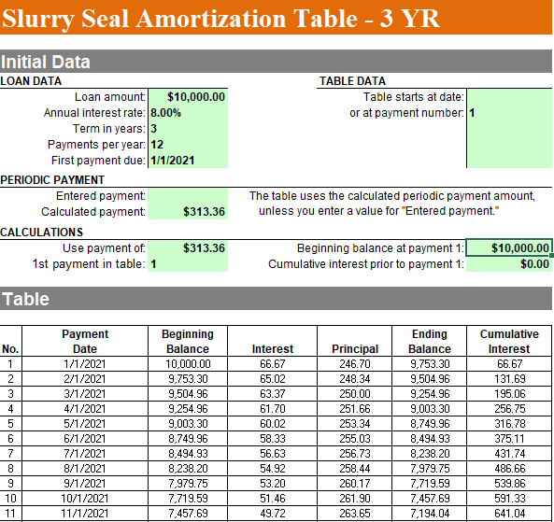
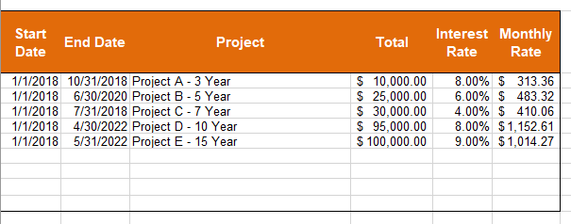
Sample Capital Amortization Schedule

Slide 5
Oh no – Expense Caps!
The cumulative nature of this cap allows Landlord to recover any unused increases from prior years.
5% cumulative cap: CAM expenses increase by 2% in year 1, the tenant would pay the 2% increase. If CAM expenses increase by 10% in year 2, then the tenant would pay an 8% increase because, in addition to the 5% cap, the landlord can recover the 3% increase that went unused in year 1.
Non-Cumulative
5% non-cumulative cap in the example above, the tenant would pay the 2% increase in year one and a 5% increase in year 2.
A non-cumulative cap sets a ceiling on annual increases in CAM expenses and does not allow the landlord to recover any unused increases from prior years.
Cumulative
Controllable
Non-controllable
Angela Gomez-jones, RPA®
Director of property Management,
Link logistics real estate
agomezjones@linklogistics.com

Slide 6
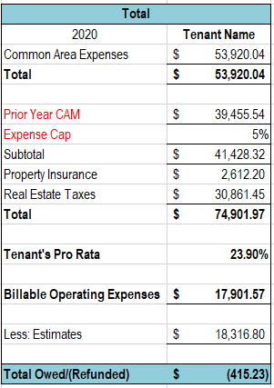
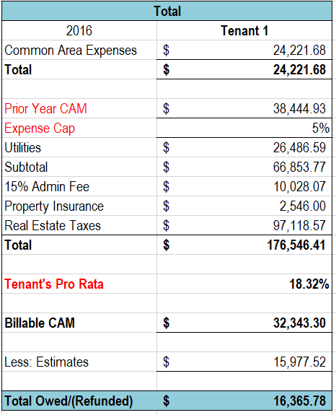
Oh no – Expense Caps!
5% non-cumulative cap on all expenses except Taxes & Insurance
5% non-cumulative cap on non-controllable expenses.
Angela Gomez-jones, RPA®
Director of property Management,
Link logistics real estate
agomezjones@linklogistics.com

