Slide 2
Budget is created for the following year
Tenant’s CAM estimates are calculated based on the budget
During that budget year, Tenants are billed (usually monthly) for their share of budgeted expenses
March/April of the following year, actual expenses are reconciled for previous year
Tenant’s billing for the prior year is reconciled against their share of actual expenses
Tenants are sent an invoice showing amount owed or (due)
CAM Reconciliation Timeline
Angela Gomez-jones, RPA®
Director of property Management,
Link logistics real estate
agomezjones@linklogistics.com

Slide 3
Lease Types
Net
Landlord maintains services and all expenses passed through
Full Service Gross
All services included during lease term, no CAM
Modified Gross/Base Year
Tenant pays increases in expenses over their base year (think of it as a “floor”)
Investment is protected from inflation
Landlord receives a fixed sum regardless of operating costs
Common with Government tenants
Or tenant maintains all services and pays all expenses directly
Angela Gomez-jones, RPA®
Director of property Management,
Link logistics real estate
agomezjones@linklogistics.com

Slide 4
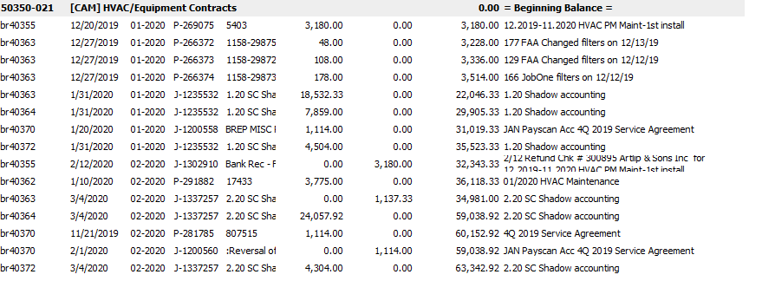
DOCUMENTS
Rent Roll
Used for determining average occupancy in order to gross up
Original Lease, Lease Amendments & Lease Abstracts
Lease type
Review for Opex clauses: exclusions, expense stops, caps
Verify pro rata: may be set, may change with building SF change
Gross Up (GU) percentage, if any
Receivables Ledger
Verify prior year tenant estimate billings
General Ledger
Determines operating expenses and should be reviewed on a monthly basis
Should be “scrubbed” prior, usually Q3 of prior year
Year End Income Statement
Used to establish initial expense pool
Angela Gomez-jones, RPA®
Director of property Management,
Link logistics real estate
agomezjones@linklogistics.com

Slide 5
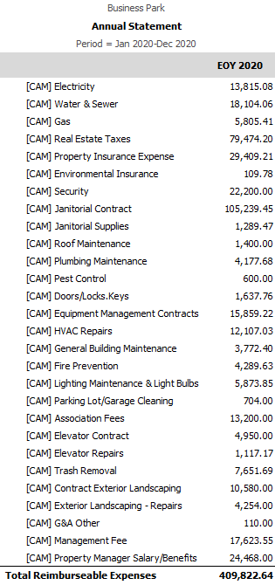
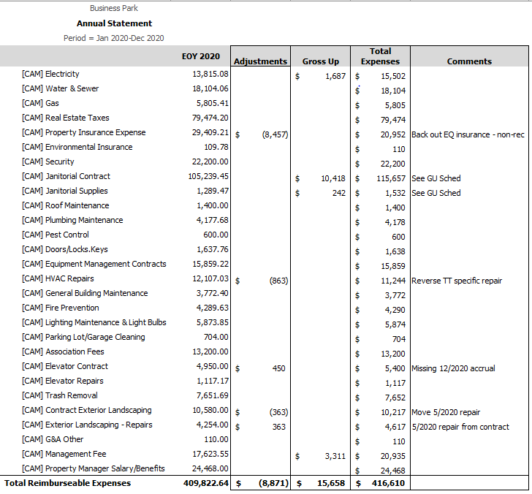
4. Total Prior Year Expenses
5. Total Adjusted Expenses

Slide 6
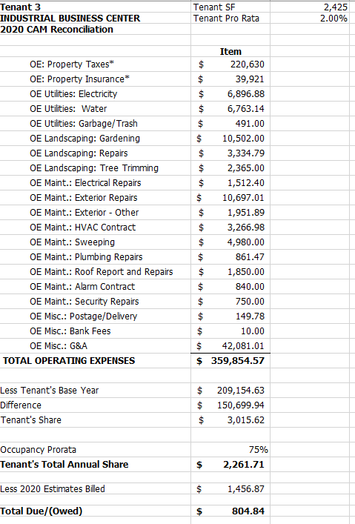
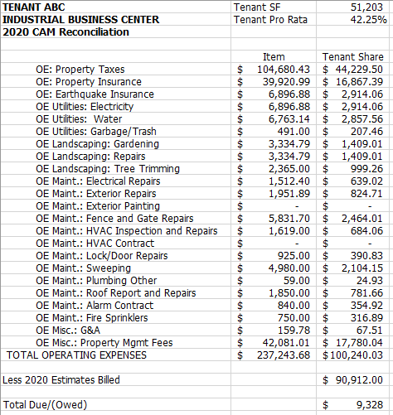
TENANT CALCULATIONS
NNN
Base Year

