Slide 2
Essentials
of
Leadership

Slide 3
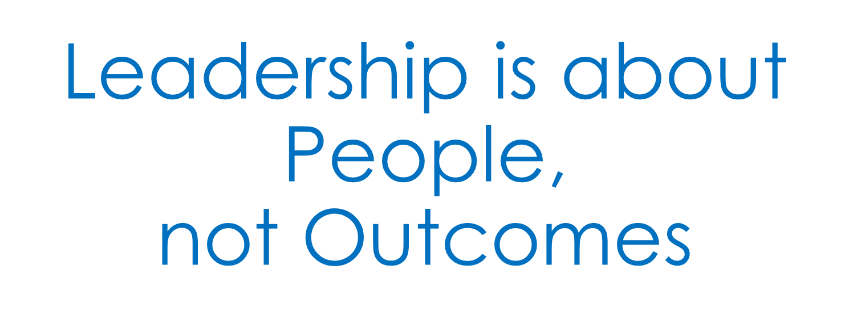

Slide 5
Great Leadership
Produces Great People *****

